Slide 1
SPACEKEY PROJECTS: KROY
User Manual

Slide 2
CONTENTS
Introduction … 3
Controls … 4
Menu Navigation … 5
Options … 6
Aim of the Game … 7
Navigating the Map … 8
Power ups … 9
Minigame … 10

Slide 3
INTRODUCTION
The year is 2042 and York has been invaded by evil extraterrestrials (ETs) from planet Kroy, who have set up fortresses in key locations (e.g. York Minster, Clifford Tower) around the city. While ETs are more technologically advanced and outgun humans, they have a major - and very convenient - weakness: they evaporate when they come in contact with water. As the leader of the Resistance, you have taken over York's old Fire Station and you are now in control of its fire engines. Your mission is to use the fire engines you control to flood the ET fortresses, and liberate York.

Slide 4
CONTROLS
Menu
Drive Forward
Drive Backward
Drive Left
Drive Right
Choosing
other trucks
The control scheme is very simple, making use of the arrow keys for movement and the escape key to enter the in-game menu.
P
ESC
M
V
V
V
V
1
2
3
4

Slide 5
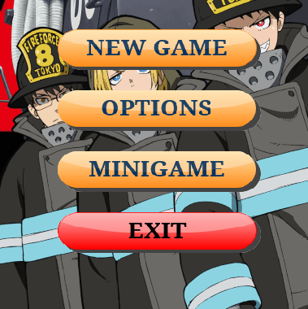
MENU NAVIGATION
On the main menu there are four buttons:
New Game: begins a new game of Kroy, and allows you to choose your desired truck with which to play the game with.
Options: takes you through to the options menu(s), allowing you to tweak and change the settings for the game such as volume and enabling/disabling music.
Minigame: launches the minigame.
Controls: shows the keys are used for game
Exit: closes the game/application.
How to navigate the in-game menus.

Slide 6
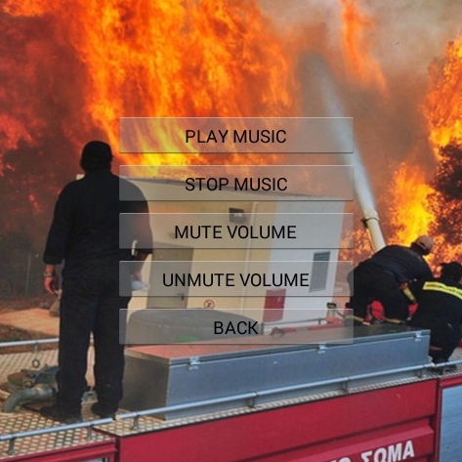
OPTIONS
When you are playing the game if you press M,P or esc keys, an option menu with 5 buttons would show up to choose from:
Resume: exits the menu and returns to the game.
Save: save the game
Load: Load the last game
Menu: takes you to the options menu (see below**).
Exit: closes the game/application.
On the options menu** there are 5 buttons:
Play/Stop Music: either enables or disables the background music.
Mute/Unmute Volume: either enables or disables all game sounds.
Back: returns you back to the main options page.
How to change the options in-game.

Slide 7
AIM OF THE GAME
Drive your fire engine around the map using the arrow keys.
Get close to ET fortresses and your truck will automatically shoot water at them.
ET fortresses will be destroyed once you have shot enough water at them.
Avoid the projectiles shot by the fortresses, you can only get hit by 10!
The blue bar above your truck shows how much water you have in your tank.
Return to the fire station (see map) in order to refill your tank with water.
You will be returned to the fire station automatically when your truck is destroyed. You only have 4 lives/trucks, so be careful!

Slide 8
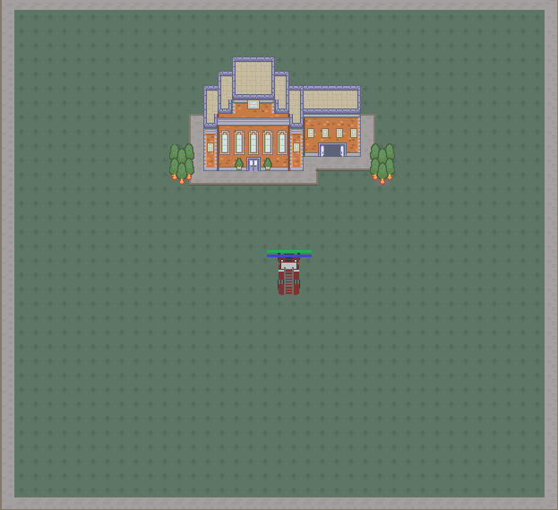
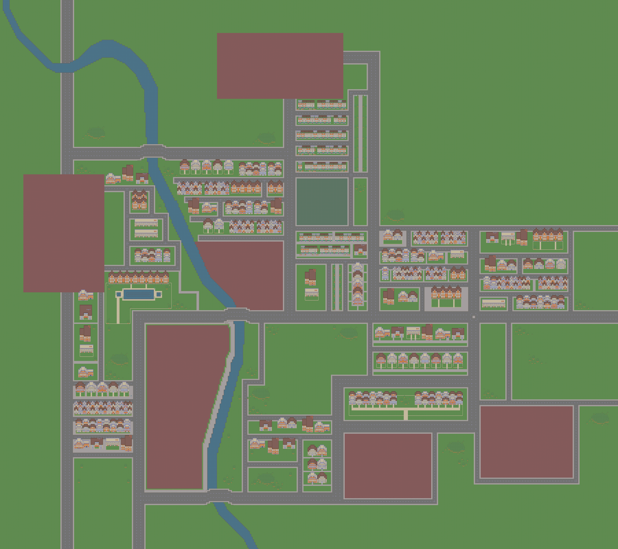
NAVIGATING THE MAP
This is the map, based on the city of York.
Drive on roads, grass and dirt, but you will not be able to drive through buildings, structures or rivers.
The fire station is your base of operations. Return here in your truck in order to refill your water tank.

Slide 9
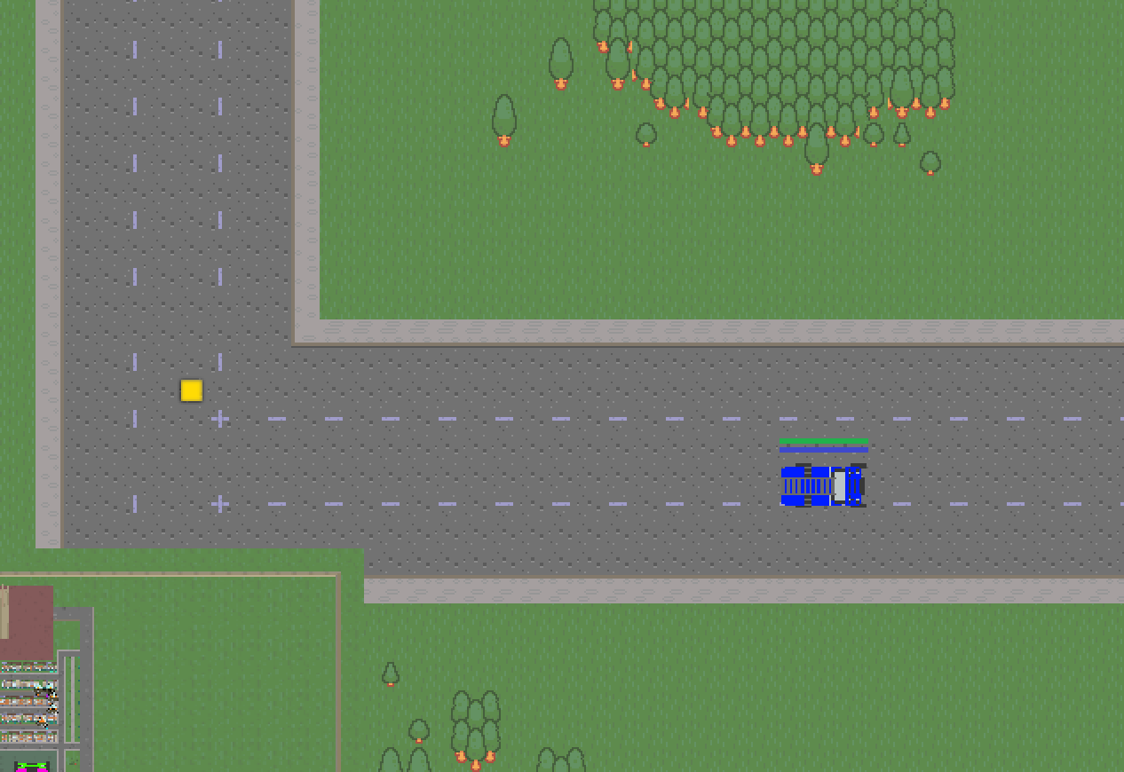
POWER UPS
Power up
During the game some power ups will show up on the map, as shown in the picture. Collecting them will give your truck a special ability or upgrade corresponding to the key below:
Colour | Upgrade
 | Increase the truck’s damage
 | Repair the truck to full health
 | Refill the truck’s water tanks
 | Increase the truck’s speed
 | Make the truck invincible for 10 seconds

Slide 10
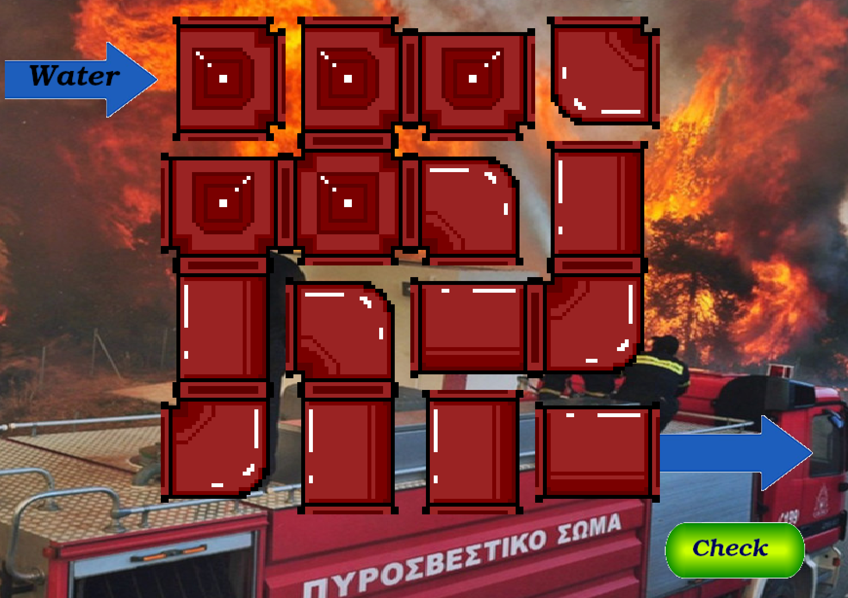
MINIGAME
Every time you return a truck to the fire station, if the truck’s health or water is not complete, a minigame will start, allowing you to refill the truck.
To complete the minigame, there must be a closed loop of pipes going from the top left corner to the bottom right. You can do this by clicking the pipes to rotate them until they are in the correct configuration.

